Slide 1
Stand Up Awareness Week
LGBTQIA+
This Photo by Unknown Author is licensed under CC BY-SA

Slide 4
What is Stand Up Awareness Week
Stand Up Awareness week is a week in which we learn about and celebrate the LGBTQIA+ community.
This is a week where we learn about homophobia and how we can help and support the members of the LGBTQIA+ in our school.
This Photo by Unknown Author is licensed under CC BY-NC

Slide 5
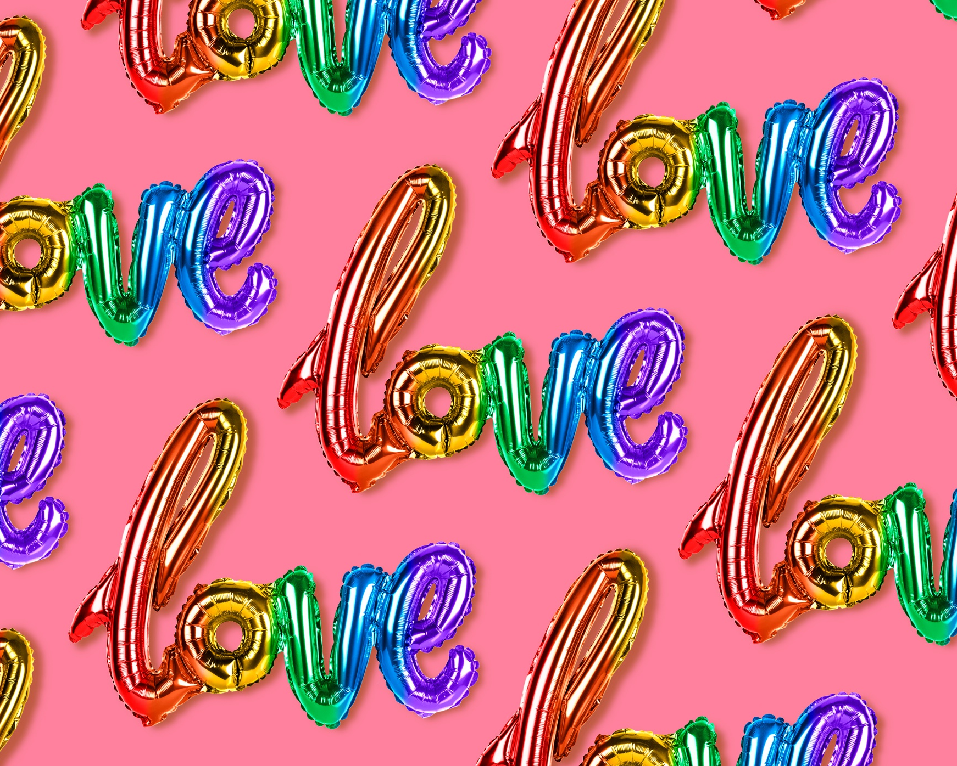
Unfortunately members of the LGBTQIA+ community are discriminated against everyday.
Nobody should ever be made feel bad because of who they love. This week is about making sure everyone in our community feels respected both in school and in society.

Slide 6
What is LGBTQIA+
LGBTQIA+ is an abbreviation of the letters used to refer to the sexualities of those represented in the LGBTQIA+ community.
The + symbol is used as an umbrella term for inclusivity in order to ensure that every sexuality is identified and included.

Slide 7
What does LGBTQIA+ stand for
L = Lesbian
G= Gay
B=Bisexual
T=Transgener
Q= Questioning or Queer
I= Intersexual
P= Pansexual
A=Adrogynous/ Asexual

Slide 8
What is a Lesbian?
A lesbian is a woman who is physically and romantically attracted to other women.

Slide 9
What does Gay mean?
Gay is when a man is physically and romantically attracted to another man.

Slide 10
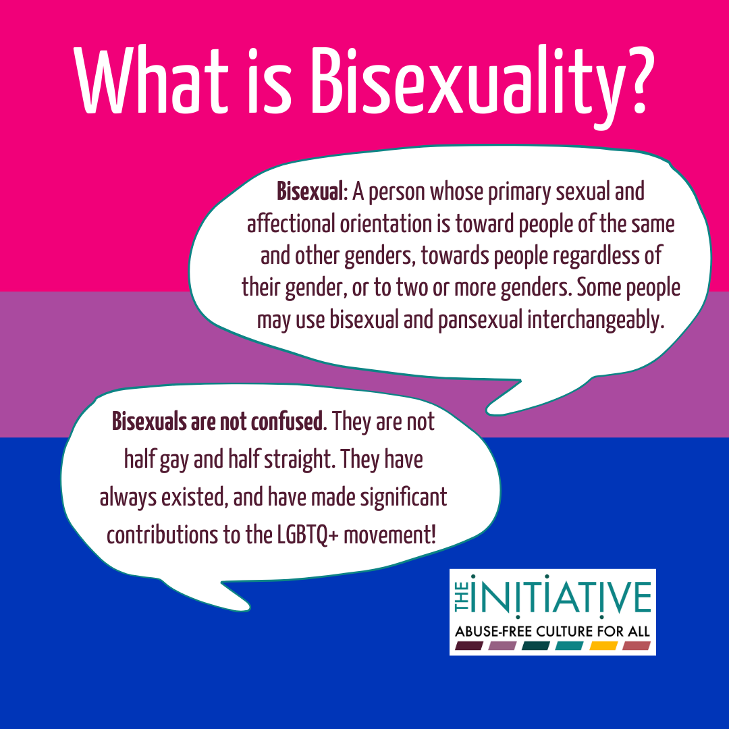
What is bisexual
Bisexual is someone is in physical and romantic relationship with men or women.

Slide 11
Transgender
Is when someone’s sex is different to the one they were born.

Slide 12
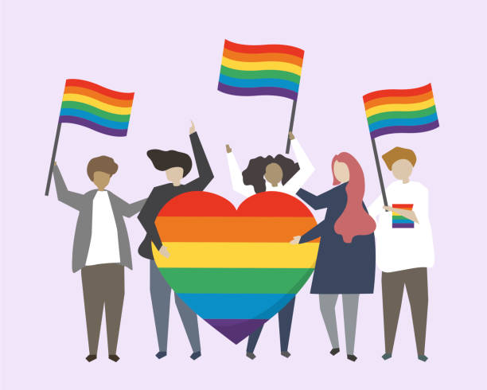
Queer
Is an umbrella term for sexual and gender minorities who are not heterosexual.
In the 19th century Queer was used as a negative term relating to someone who was gay.
In the 1980s queer was used as a positive self-identifier term.

Slide 13
Questioning
A term used for people who are discovering their sexual orientation.

Slide 14
Intersexual
Intersex is a general term used for a variety of conditions in which a person is born with a reproductive or sexual anatomy that doesn’t seem to fit the typical definitions of female or male.
For example, a person might be born appearing to be female on the outside, but having mostly male-typical anatomy on the inside.

Slide 15
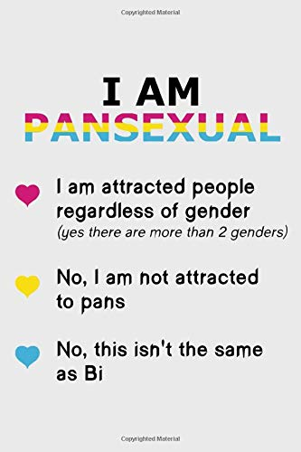
What is Pansexual?
Pansexual means (not limited in sexual choice with regard to biological sex, gender or gender identity).
Pansexual may refer to themselves as being gender blind and sex is not a determining factor in romantic or sexual attraction.

Slide 16
Asexual
Asexual is a lack of sexual attraction to others.

Slide 17
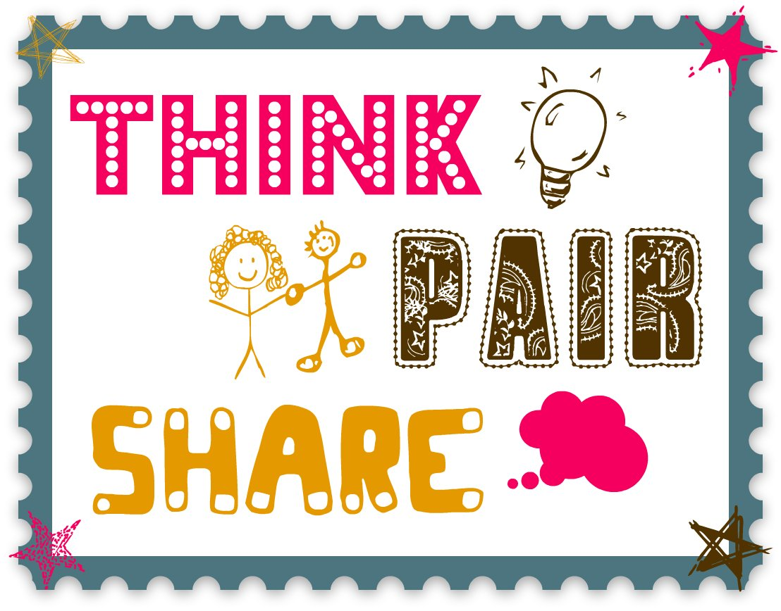
How do you think people in the LGBTQIA+are discriminated in Ireland?

Slide 18
People who refer to themselves as LGBTQ+ are subjected to abuse at home, in public, in school or in work.
This is due to a societal construct created by the people who lived before us. Which many people believe to be justifiable today.
A lot of the harassment experienced by members of the LGBTQ+ community begins in school. This causes the people being bullied to feel worthless, and disgusting. The person doing the bullying displays a homophobic mindset.

Slide 19
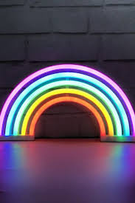
What is homophobia?

Slide 20
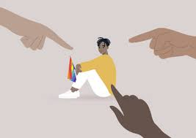
Homophobia
Homophobia: is defined as the fear, hatred, discomfort with, or mistrust of people who are lesbian, gay, or bisexual.

Slide 21
Biphobia
Biphobia is defined as the the fear, hatred, discomfort, mistrust specifically of people who are bisexual.

Slide 22
Transphobia
Transphobia is defined as the fear, hatred, discomfort, mistrust specifically of people who are transgender.

Slide 23
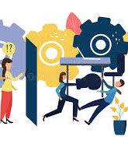
Gender role
A gender role is a social role that encompasses the behaviours and attitudes that are considered to be acceptable, appropriate or desirable for a person’s biologiacal or perceived gender.
Example: Boys like blue, like cars, machinery.
Girls like pink and dolls.

Slide 24
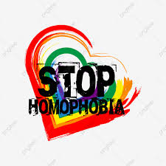
What is considered as homophobia/Biphobia or Transphobia?

Slide 25
Insensitive jokes
Slurs
Exclusion of a person because they identify as LGBTQ+
Treating someone differently because they belong to LGBTQ

Slide 26
Do you think this happens in your school?

Slide 27
How do you think you can support LGBTI+ community in our school.

Slide 28
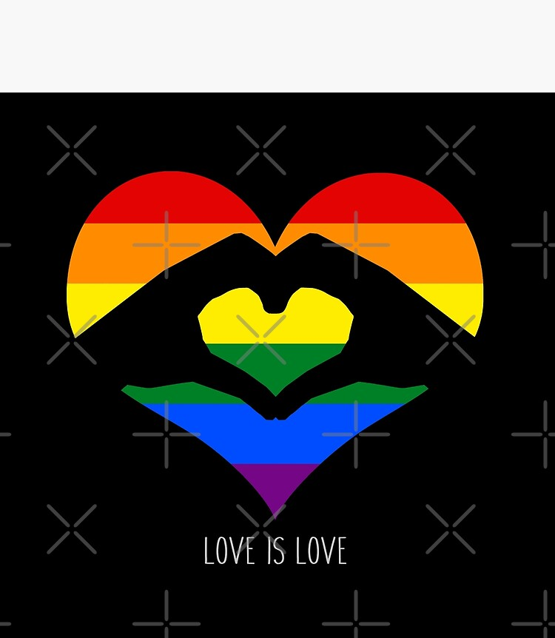
Everyone deserves to be treated with respect in school. Nobody should be treated differently for who they choose to love. Everyone deserves to live their idea of a happy life.

